Slide 1
BICT 231
SYSTEMS ANALYSIS AND DESIGN
BICT 231 Bugema University

Slide 2

Name: Tibenda Seth
Email: tibendastpa@bugemauniv.ac.ug
BICT 231 Bugema University

Slide 3
Course aim
The course aims to give students
an understanding of the approaches,
methodologies, techniques and
steps involved in analysing, designing,
testing and implementing a computer
based information system.
BICT 231 Bugema University

Slide 4
Course Objectives
At the end of the course students should be able:
1. To apply information systems concepts to an information system problem.
2. To understand and apply Systems Development Life Cycle concepts.
3. To document the overall structure of data flow for a business problem.
BICT 231 Bugema University

Slide 5
Objectives (cont)
4. To document requirements and design of computer generated outputs.
5. To document computer programming specifications for a system.
6. To organize & present the documentation for a system in a technical report.
BICT 231 Bugema University

Slide 6
Course outline
The topics covered include:
Course overview
Introduction to information systems analysis and design.
The system development lifecycle
Preliminary Investigation and Feasibility study
Requirements determination
BICT 231 Bugema University

Slide 7
Course outline - continued
6. Information gathering techniques
7. System analysis tools and techniques
8. System design
9. System Implementation, Evolution and Review
10.Information systems project management
11.Case Studies
BICT 231 Bugema University

Slide 8
Pedagogy
Teaching / Learning approach :
The teaching and learning approaches will combine classroom lectures, group discussions, quizzes and take home assignments. Take home assignments and quizzes shall form part of the coursework. The material presented in class will overlap that of the text but will contain additions and variations.
BICT 231 Bugema University

Slide 9
Students Performance Evaluation
Students Are Evaluated Through:
  Coursework (50%) consisting of :
    Three Individual Assignments
    One group assessments
    Mid-SemesterTests
  Final examination (50%)
BICT 231 Bugema University

Slide 10
Class Attendance & Participation
How to be an active participant?
  Attend all classes and be always on time
  Complete scheduled readings before class
  Do class exercises
Each student is encouraged to be an active participant by expressing his/her ideas and opinions
BICT 231 Bugema University

Slide 11
Course Policies
Assignments Due Dates
    Late submissions shall not be accepted
    No student homework for a particular assignment will be accepted after the grades for that assignment are turned back to class
    If you have problems that prevent you from meeting the preparation and assignment schedule, you must let me know in advance
Missed Quiz
  A missed quiz will receive a grade of zero
  No make up quiz will be given
BICT 231 Bugema University

Slide 12
Course overview
This course introduces the theory and application of information systems analysis and design.
Information systems and the systems development life cycle are described.
Tools and techniques for documenting information systems are presented.
BICT 231 Bugema University

Slide 13
Course overview (cont)
Classical and structured tools for describing data flows, data structures, process flows, file design, input and output design and program specification are explained.
The primary theme of the course is the use of systems analysis and design techniques to develop and document effective computer based information systems.
BICT 231 Bugema University

Slide 14
Course overview (cont)
Systems analysis and systems design are primarily done by the systems analyst.
Systems analysis, design, and implementation are processes used by professionals to develop and maintain Information systems.
BICT 231 Bugema University

Slide 15
1. Introduction
BICT 231 Bugema University

Slide 16
What is systems analysis?
Systems analysis
System analysis is the study of an organization's problem or situation and the specification of business requirements for an improved system.
BICT 231 Bugema University

Slide 17
What is systems design?
Systems design
Is the detailed specification of a computer based solution to the business requirements.
The design includes the programming specifications.
BICT 231 Bugema University

Slide 18
What is systems analysis and design?
Systems Analysis and Design covers the entire systems development process from:
    Planning to implementation, maintenance, and evolution.
It includes all activities performed to produce an automated IS.
BICT 231 Bugema University

Slide 19
Justification – why do analysis and design ?
Why Systems analysis?
Projects do not succeed by chance
Successful IT projects follow a systematic “analysis and design” process in order to improve chances of success.
BICT 231 Bugema University

Slide 20
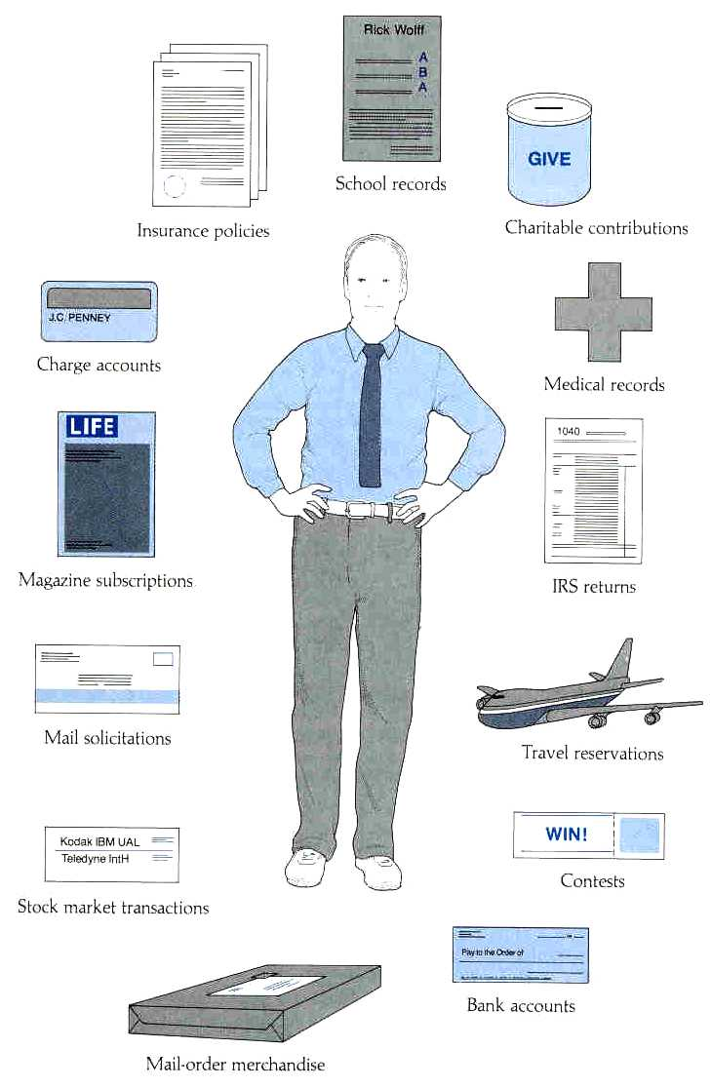
Information Systems
Almost all of our daily transactions are recorded on an Information System somewhere.
BICT 231 Bugema University

Slide 21
Systems and subsystems
System Definition:
It is a set of interrelated, interacting components that function together to achieve specific results.
An effective system is Synergistic (agents of the system working together)
BICT 231 Bugema University

Slide 22
Systems and Sub-systems
Business systems are composed of:
People, facilities, equipment, materials and methods of work
that function together to provide goods or services
BICT 231 Bugema University

Slide 23
Subsystems
Subsystems - exist where main system becomes complex
Manufacturing example:
input
o/p
o/p
output
Fabricating
Finishing
Shipping
i/p
i/p
SUBSYSTEM
A
SUBSYSTEM
B
SUBSYSTEM
C
BICT 231 Bugema University

Slide 24
Typical business systems
Interaction of major systems
Purchasing
Sales
Inventory
Marketing
Shipping
Personnel
Finance
BICT 231 Bugema University

Slide 25
Typical business systems and subsystems
Subsystems for the finance system
General
Ledger
Finance
Credit
Payroll
Accounts
Receivable
Accounts
Payable
BICT 231 Bugema University

Slide 26
Main types of information systems
1. Transaction Processing System (TP)
2. Office Automation Systems (OAS)
3. Management Information System (MIS)
4. Decision Support System (DSS)
5. Strategic Information System (SIS) or (EES)
6. Expert System (ES)
BICT 231 Bugema University

Slide 27
Transaction processing system
Controls routine daily activities of an organization
Typically large volumes of data
Transaction is an event that affects the organization
Transaction processing cycle includes:
  recording, processing, updating, output, report
BICT 231 Bugema University

Slide 28
Transaction processing system
Examples of transactions include ...
  receive payment
  place order
  refund purchase
BICT 231 Bugema University

Slide 29
Office Automation Systems (OAS)
At the “knowledge” level of an organization
Use information for analysis
Familiar aspects of OAS include:
  word processing, desktop publishing
  spreadsheets, scheduling
  voice mail, electronic mail
BICT 231 Bugema University

Slide 30

Management Information System
Deals with summary information from TP system
Exception conditions
require closer attention
(where special action is required) are reported
BICT 231 Bugema University

Slide 31
Decision Support System (DSS)
Strategic Planning
Set long-term goals
Uses internal results from TPS and MIS
Also uses external (statistical) data
Build model for future state of the business
Group Decision Support System (GDSS)
  uses group problem solving
BICT 231 Bugema University

Slide 32
5. Strategic Information System (SIS) or Executive Support System (ESS)
Designed to give a firm competitive advantage within an industry
Michael Porter identified 5 ways:
  Build barriers against potential competitors.
  Enhance customer loyalty.
  change the basis of competition within an industry
  develop new products
Example: American Airlines - first to create
on-line ticket reservation system
BICT 231 Bugema University

Slide 33
Expert System (ES)
Part of the field of Artificial Intelligence
Computer system which guides user through tasks requiring special knowledge
Contains “knowledge base” which includes both data and decision rules
Examples: medical diagnosis, oil exploration
BICT 231 Bugema University

Slide 34
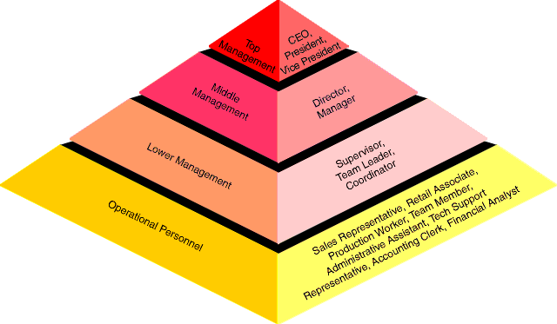
Organisation Levels and IS requirements
BICT 231 Bugema University

Slide 35
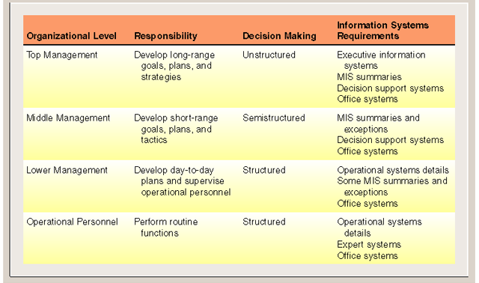
Organisation levels and IS requirements
BICT 231 Bugema University

Slide 36
System boundary
Need to draw the system boundary line somewhere
System Boundary
Interactions
Interactions
SYSTEM
Interactions
ENVIRONMENT
Interactions
BICT 231 Bugema University

Slide 37
System boundary…cont
A boundary (scope)
What is the perimeter or border of the system – elements, features, options, that will be included in the system.
What is the area under investigation?
What is the boundary of the system?
What parts of the organization are off limits?
BICT 231 Bugema University

Slide 38
Components of an information system
Input - data, the raw material
Process - transform data into useful information
Output - product or result
Feedback - for quality control, evaluate results
Adjustments - where corrections are necessary
BICT 231 Bugema University

Slide 39
Components of an information system- a general example
Input
Output
Source
Processing
Destination
Adjustments
Feedback
Control
BICT 231 Bugema University

Slide 40
Basic Characteristics of an IS
Data: input, stored, or output
Function: business activity performed
Behaviour: the observable effects of a request
Data
Functions
Behaviour
BICT 231 Bugema University

Slide 41

The system analyst
She or he performs Systems Analysis
Usually employed in the Information Systems department
Has Wide ranging skills
BICT 231 Bugema University

Slide 42
The system analyst..(cont)
A system analyst studies the problems and needs of an Organisation.
To determine how people, methods, and computer technology can best accomplish improvements for the business.
BICT 231 Bugema University

Slide 43
Role of a systems analyst
1. Investigate how information is used, handled and manipulated in an organization.
2. Identify inefficiencies and ineffectiveness in the current system used by the organization e.g. delays, high operating costs, huge clerical effort and health hazards.
3. Analyze the results of the investigation that will lead to designing the new system.
BICT 231 Bugema University

Slide 44
Role of a systems analyst (cont)
4. Design a specification of a new system which overcomes the inefficiencies and meets the organization objectives.
5. Oversees the process of testing during the testing of the system.
BICT 231 Bugema University

Slide 45
Role of a systems analyst (cont)
6. The analyst acts as a facilitator.
  He/She interfaces among many different types of people and
  facilitates the development of computer applications through these people.
BICT 231 Bugema University

Slide 46
Stakeholders of an information system
Users
Managers
Steering
Committee
Systems
Analyst
Database
Administrators
The steering committee is formulated in the organization to oversee the Systems study and thereafter.
Vendors
Programmers
& Technical
Staff
BICT 231 Bugema University

Slide 47
Tasks of a systems analyst
Systems analyst tasks include
Investigation
Planning
Understanding
Communication
Documentation
BICT 231 Bugema University

Slide 48
Qualities of a systems analyst
  Working knowledge of IS Techniques and Technology.
  Computer Programming Knowledge
  Problem-solving skills (creativity)
  Interpersonal Relations skills (confidence, persistent, patience)
  Interpersonal communication skills
  Ongoing interest in updating one’s knowledge in IT.
BICT 231 Bugema University

Slide 49
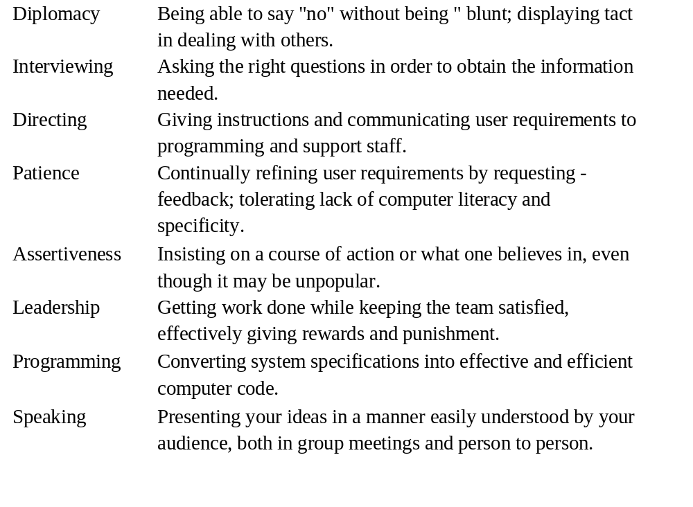
Systems Analyst skills - Behavioural &Technical

Slide 50
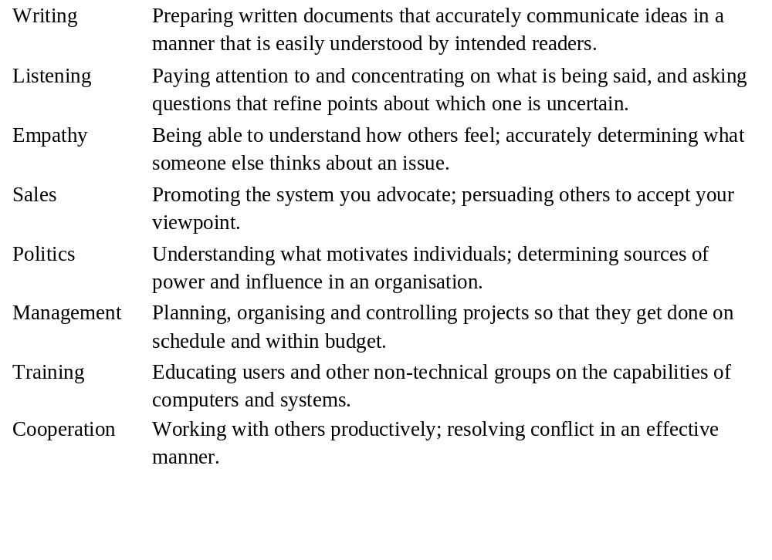
Systems Analyst skills - Behavioural &Technical
BICT 231 Bugema University

Slide 51
Where do information Systems Projects Originate?
Problems – may either be current, suspected, or anticipated. Problems are undesirable situations that prevent the business from fully achieving its purpose, goals, and objectives.
An Opportunity – is a chance to improve the business even in the absence of specific problems.
A Directive – is a new requirement that is imposed by management, government, or some external influence i.e. are mandates that come from either an internal or external source of the business.
BICT 231 Bugema University

Slide 52
Review Questions
Describe the role of a systems analyst in the systems development process.
Discuss the importance of recognising system features and system boundaries as it relates to systems development.
Describe and differentiate at least four different system types which fall under the umbrella of ‘information systems’.
BICT 231 Bugema University

Slide 53
References
Systems Analysis and Design by Don Yeats, Maura Shields and David Helmy ISBN 0-273-60066-4
Systems Analysis and Design by Kendall EK and Kendal JE ISBN 0-13-654229-8
An introduction to Systems Analysis Techniques by Mark Lejk and David Deeks; ISBN 0-13-857764-1
BICT 231 Bugema University

